Slide 1
Template Matching Using Cross - Corelation

Slide 2
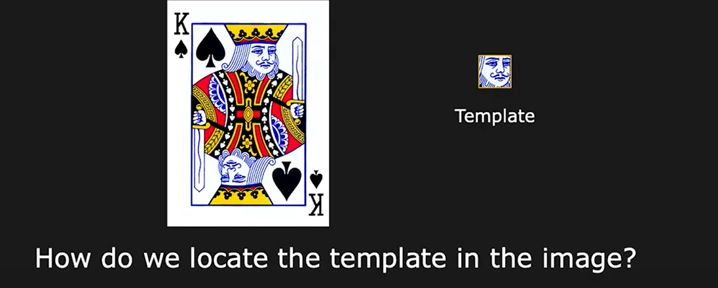

Introduction

Slide 3
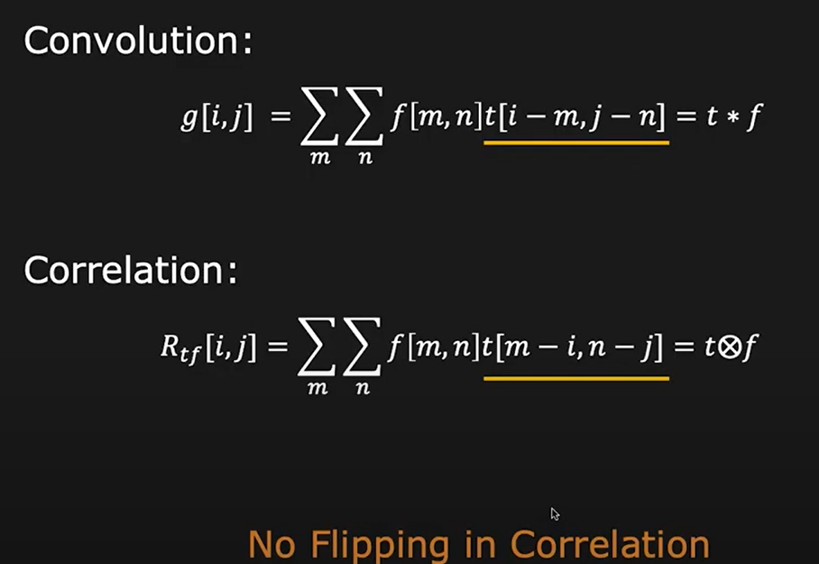

Slide 4
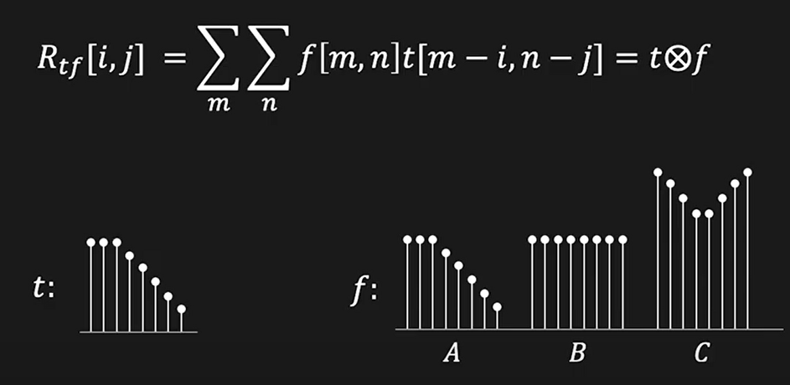


Slide 5
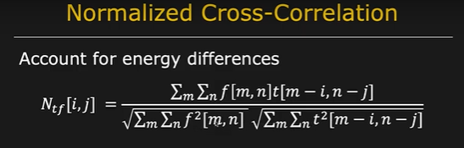
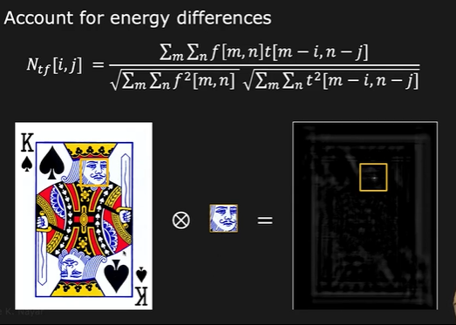
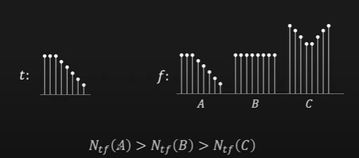

Slide 6
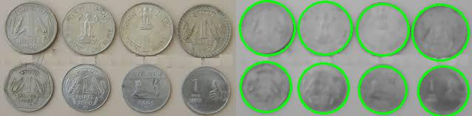
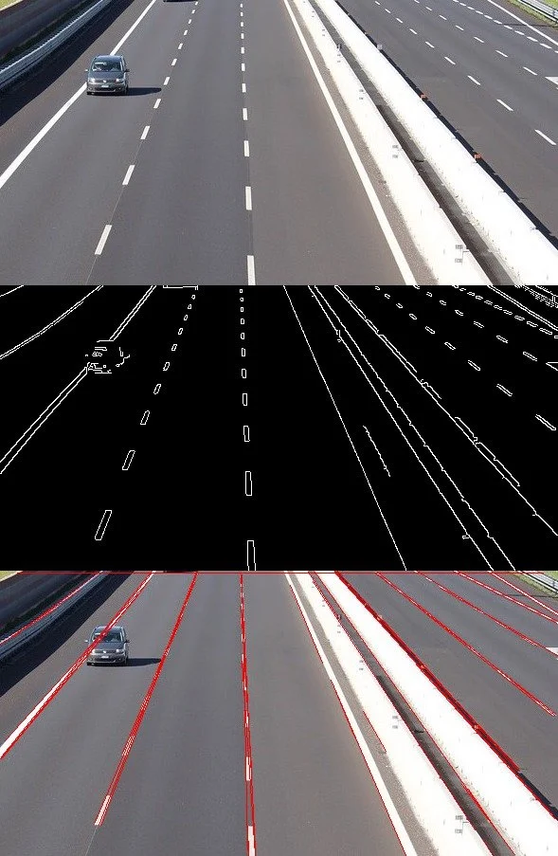
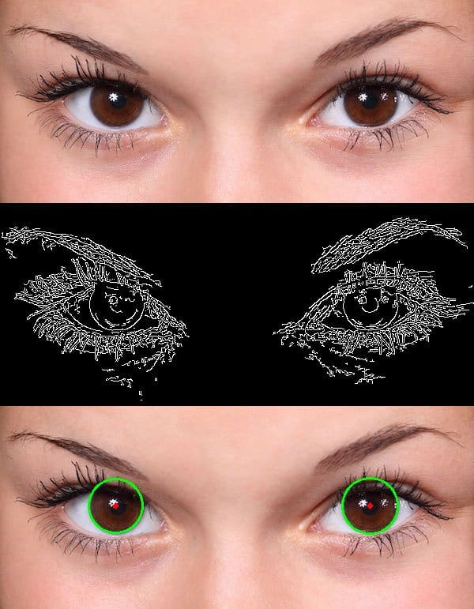
Hough Transform
Hough transform is a feature extraction method for detecting simple shapes such as circles, lines etc in an image
Line can be represented by two parameters (slope, intercept)
Circle has three parameters — the coordinates of the center and the radius (x, y, r).
Hough transform does an excellent job in finding such shapes in an image.
The main advantage of using the Hough transform is that it is insensitive to occlusion

Slide 7
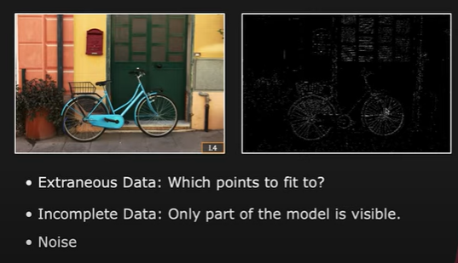
Hough Transform – Boundary Detection

Slide 8
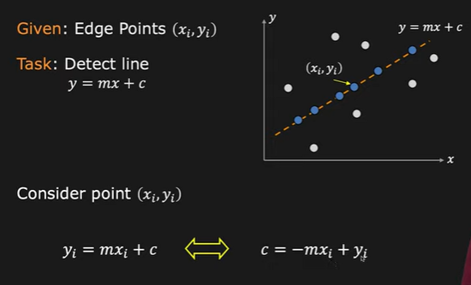
Hough Transform – Boundary Detection

Slide 9
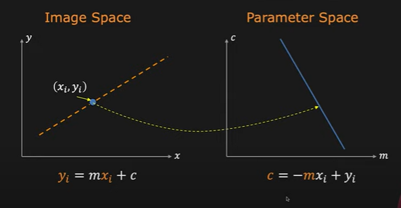
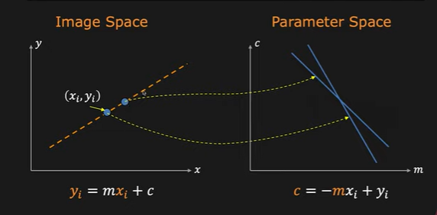
Hough Transform – Concept

Slide 10
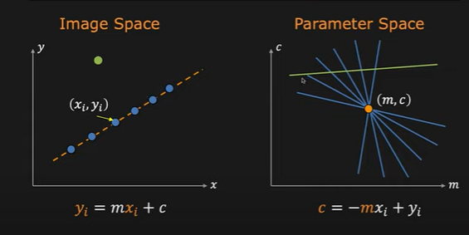

Slide 11
Prune and Search
https://www.geeksforgeeks.org/prune-and-search-a-complexity-analysis-overview/

Slide 12
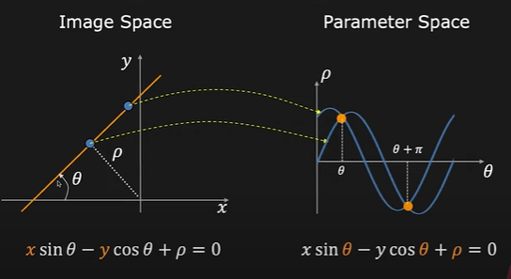
Better Parameterization

Slide 13
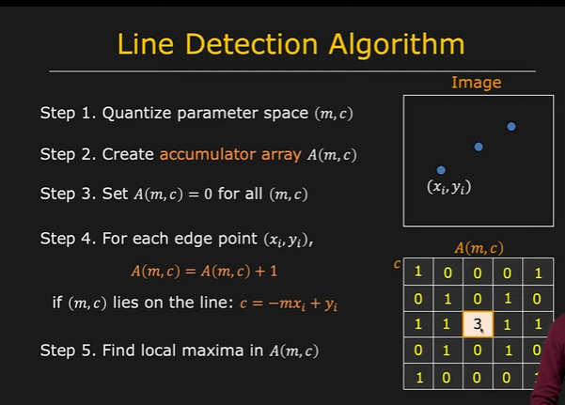
1 | 0 | 0 | 0 | 1
0 | 1 | 0 | 1 | 0
1 | 1 | 3 | 1 | 1
0 | 1 | 0 | 1 | 0
1 | 0 | 0 | 0 | 1

Slide 14
1 | 0 | 0 | 0 | 1
0 | 1 | 0 | 1 | 0
1 | 1 | 3 | 1 | 1
0 | 1 | 0 | 1 | 0
1 | 0 | 0 | 0 | 1

Slide 15
1 | 0 | 0 | 0 | 0
0 | 1 | 0 | 0 | 0
0 | 0 | 1 | 0 | 0
0 | 0 | 0 | 1 | 0
0 | 0 | 0 | 0 | 1
1 | 0 | 0 | 0 | 1
0 | 1 | 0 | 1 | 0
1 | 1 | 3 | 1 | 1
0 | 1 | 0 | 1 | 0
1 | 0 | 0 | 0 | 1
1 | 0 | 0 | 0 | 1
0 | 1 | 0 | 1 | 0
0 | 0 | 2 | 0 | 0
0 | 1 | 0 | 1 | 0
1 | 0 | 0 | 0 | 1

Slide 16
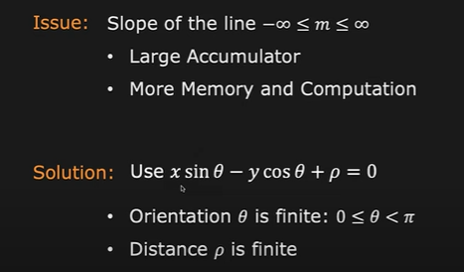
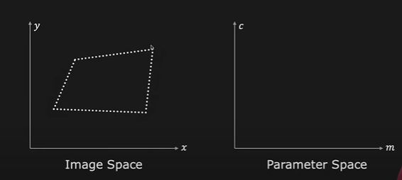
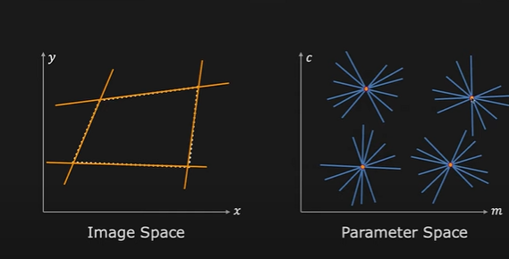
Multiple Line Detection

Slide 17
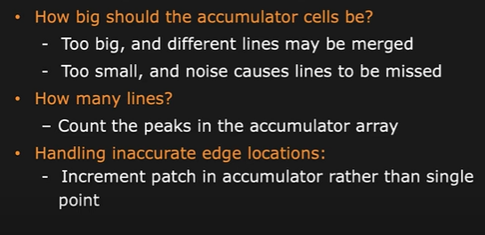
Hough Transform Mechanics

Slide 18
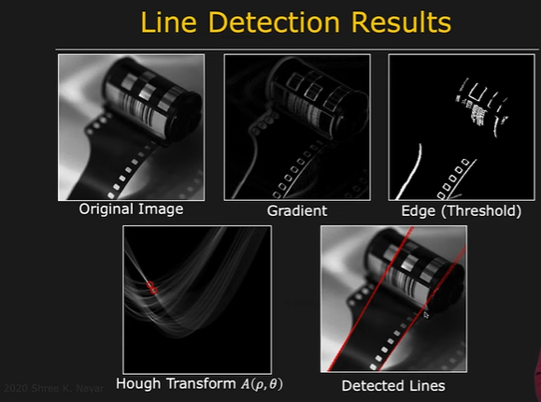
Hough Transform Mechanics

Slide 19
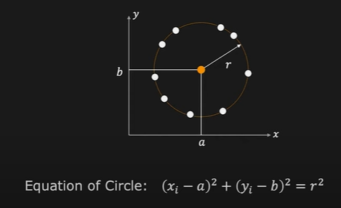
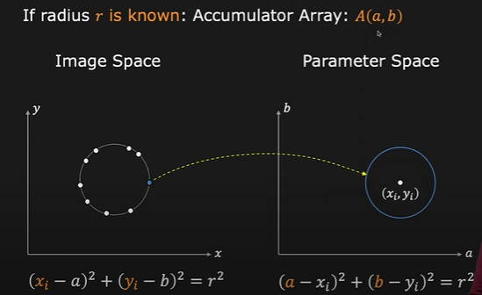
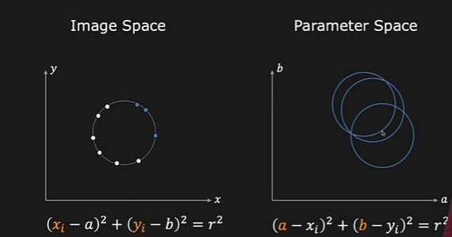
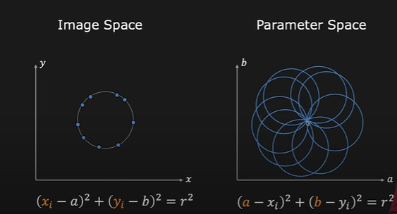
Hough Transform - Circle Detection

Slide 20
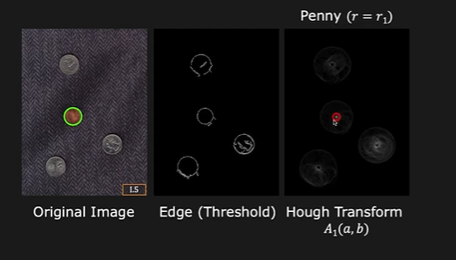
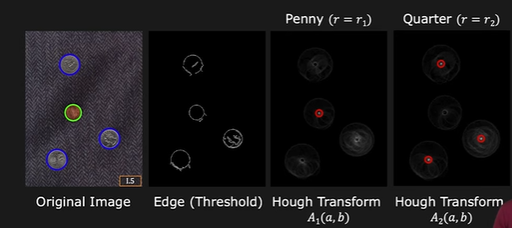
Hough Transform - Circle Detection

